Slide 1
Logical Agents
Resolution
Prof. Tarachand Amgoth

Slide 2
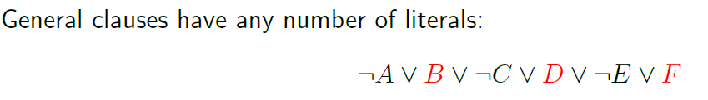
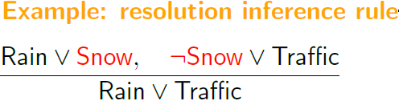

Resolution

Slide 3
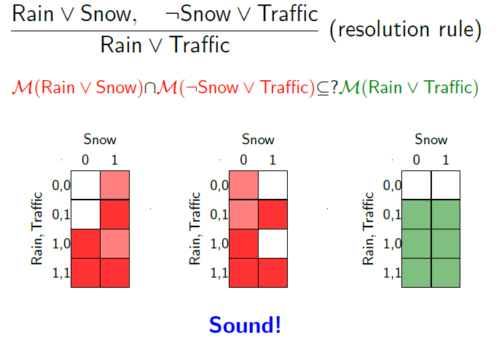
Soundness of Resolution

Slide 4
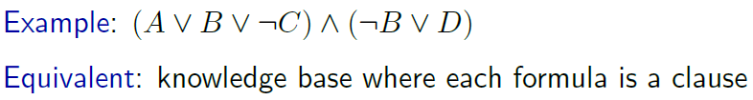
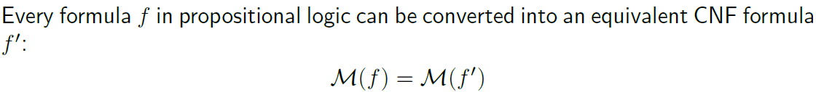
Conjunctive Normal Forms

Slide 5
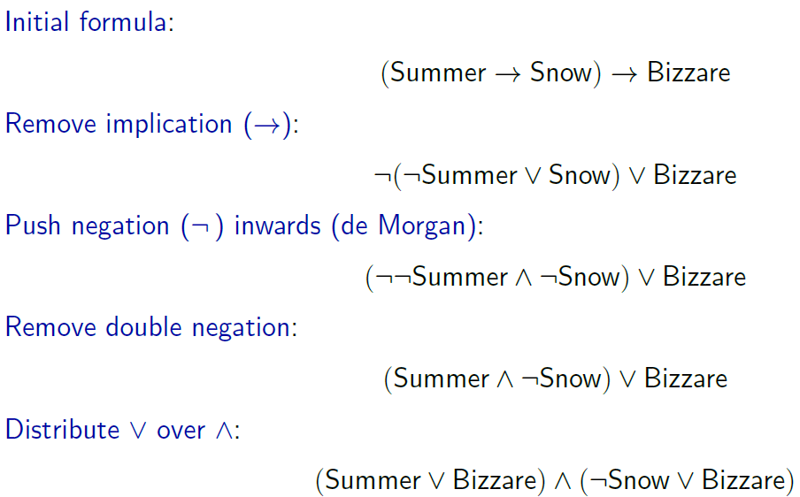
Conversion to CNF: Examples

Slide 6
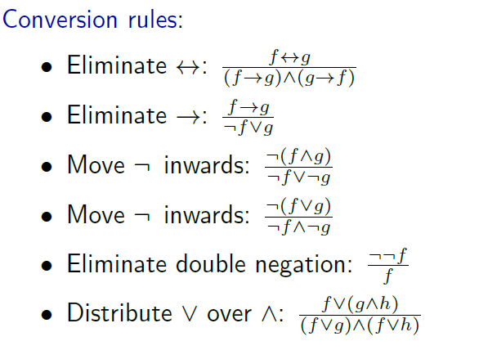
Conversion to CNF: Rules

Slide 7
Conversion to CNF: Rules
Eliminate Biconditionals (↔)
Replace biconditional statements A ↔ B with two implications:
A ↔ B ⇒(A → B) ∧ (B → A)
For example, P ↔ Q becomes (P → Q) ∧ (Q → P).
Eliminate Implications (→)
Rewrite implications using disjunctions: A→B⇒¬A∨
For example, P → Q becomes ¬P ∨ Q.

Slide 8
Conversion to CNF: Rules
Move NOT Inwards (Use De Morgan’s Laws)
Push negations (¬) down to individual literals by using De Morgan’s laws:
  ¬(A ∧ B) ⇒ ¬A ∨ ¬B
  ¬(A ∨ B)⇒¬A ∧ ¬B
Also, remove any double negations: ¬(¬A) ⇒ A
Distribute OR over AND (Distributive Law)
Apply the distributive law to get a conjunction of disjunctions:
A ∨ (B ∧ C) ⇒ (A ∨ B) ∧ (A ∨ C)
A ∨ (B ∧ C) ⇒(A ∨ B) ∧ (A ∨ C)
Continue applying this rule until the entire formula is in CNF.

Slide 9




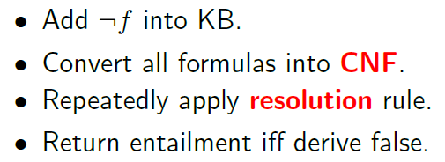
Resolution Algorithm

Slide 10
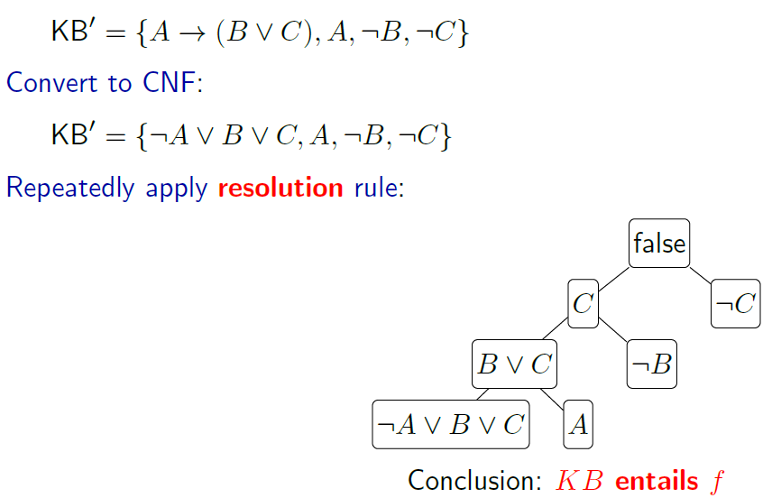
Resolution Algorithm: Example

Slide 11
Resolution Algorithm: Example
Convert the following sentence into CNF: (P→(Q∧R))→S
Eliminate Implications:
Apply implication elimination to the innermost implication first:
  P→(Q∧R) becomes ¬P∨(Q∧R).
  Then, apply the outer implication:
  (¬P ∨ (Q ∧ R)) → S ⇒ ¬(¬P (Q ∧ R)) ∨ S
Move NOT Inwards:
  Apply De Morgan’s laws to ¬(¬P∨(Q∧R): ¬(¬P ∨ (Q ∧ R))⇒P ∧(¬Q ∨¬R)
  Now the formula is: (P∧(¬Q∨¬R))∨S
Distribute OR over AND:
  Distribute S over the conjunction (P ∨ S) ∧ ((¬Q ∨¬R) ∨ S)
Resulting CNF:
  The final CNF form is: (P ∨ S)∧(¬Q ∨¬R ∨ S)

Slide 12
Resolution Algorithm: Example
(P→(Q∧R))→S

Slide 13
Resolution Algorithm: Problems
1. (P ↔ Q) →R
      The CNF form is: (P∨R)∧(¬Q∨R)∧(Q∨R)∧(¬P∨R)
2. (P ∨ (Q → R)) ∧ S
      The CNF form is: (P∨¬Q∨R)∧S
3. ¬((P → Q) ∧ (R ∨ S))
      The CNF form is: (P∨¬R)∧(P∨¬S)∧(¬Q∨¬R)∧(¬Q∨¬S)

